Slide 1

Python Fundamentals
Course Introduction
SoftUni Team
Technical Trainers
Software University
https://softuni.bg/

Slide 2
Table of Contents
Course Objectives
Training and Team
Course Organization
Course Infrastructure
Evaluation Criteria

Slide 3
Have a Question?
sli.do
#fund-python

Slide 4

Course Objectives

Slide 5
Python Fundamentals Objectives
Working with linear data structures
Lists
Defining functions and simple classes
Working with objects
Processing and manipulating strings
Regular expressions

Slide 6
Practical Programming Exam
Mid Exam – 4 hours
3 practical problems
Conditional Statements and Loops
Linear Data Structures – Lists
Final Exam – 4 hours
3 practical problems
Dictionaries
Strings and Text Processing
Regular Expressions

Slide 7
Theoretical Exam
You will have 30 minutes once you enter
Multiple-choice with 1 or more correct answers
English
Automated quiz system
Available online the day before the practical exam
You can submit your answers just one time

Slide 8

The Team

Slide 9
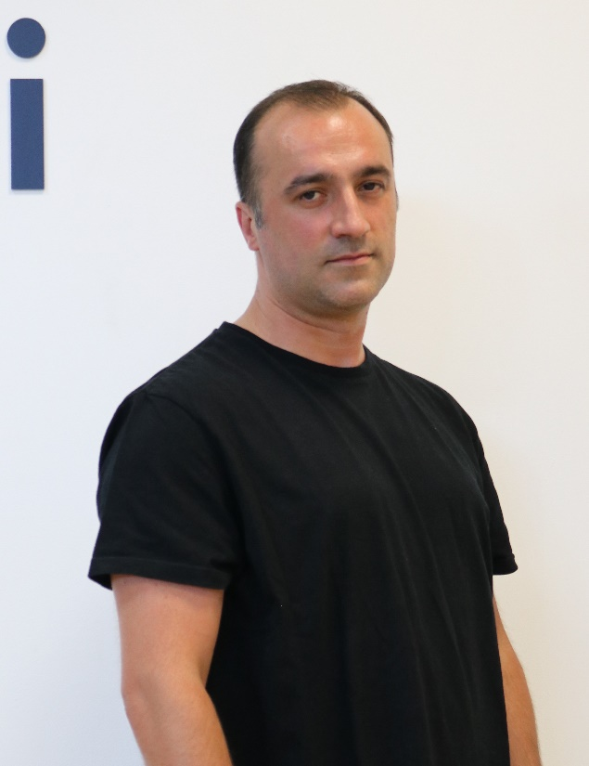
Dobri Stoilov
Has Master Degree in Applied Mathematics
Works in the IT industry since year 2000
Works with Python since year 2009
Since 2014 works as a senior Python Web developer
Has many successful projects in the area of web applications and machine learning

Slide 10
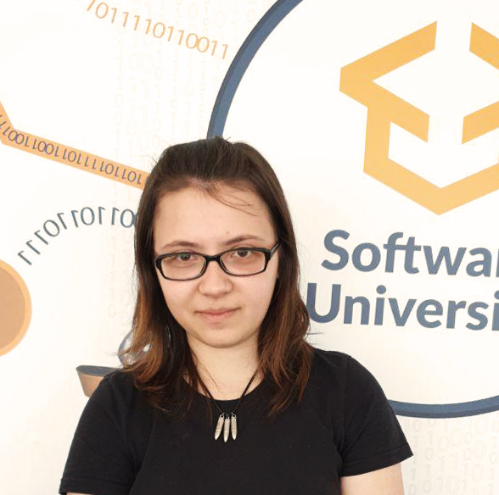
Tanya Staneva
Technical Trainer and Program Lead at SoftUni
SoftUni Top Student
Passionate about Python technologies
Interested in Machine Learning and AI

Slide 11

Course Organization

Slide 12
Python Fundamentals Module
16-Sept-2019
2-Nov-2019
7-Dec-2019
13-Dec-2019
Python Fundamentals
12 weeks * 3 times / week
18 credits
Start: 16-Sept-2019
Mid Exam: 2-Nov-2019
Theoretical Exam: 6-Dec-2019
Final exam: 7-Dec-2019
Re-Take Exams
Mid Exam Retake: 10-Dec-2019
Тheoretical Exam: 12-Dec-2019
Final Exam Retake : 13-Dec-2019

Slide 13

Homework Assignments & Exercises
Your homework is mainly work in class
Lesson days → slides + live demos + exercises
Exercise days → only exercises
How to submit your homework?
Submitted in the judge system
Do your homework when it's due
Assignments pile up quickly

Slide 14



Scoring System for the Course
Theoretical Exam 5%
Practical Exam (Final + Mid) 90%
Presence in class 5%
Evaluation
Homework 5 %

Slide 15



Course Web Site, Forum and FB Group
Official web site:
Official discussion forum:
Official Facebook group:
Softuni Python Community group:
https://softuni.bg/python-fundamentals
softuni.bg/forum/categories/44/
facebook.com/groups/FundamentalsModuleSeptember2019/
https://www.facebook.com/groups/SoftUniPythonCommunity

Slide 16
https://softuni.bg/modules/70/fundamentals-module/1197

Slide 17












SoftUni Diamond Partners

Slide 18




SoftUni Organizational Partners

Slide 19




Trainings @ Software University (SoftUni)
Software University – High-Quality Education and Employment Opportunities
softuni.bg
Software University Foundation
http://softuni.foundation/
Software University @ Facebook
facebook.com/SoftwareUniversity
Software University Forums
forum.softuni.bg

Slide 20

License
This course (slides, examples, demos, videos, homework, etc.) is licensed under the "Creative Commons Attribution-NonCommercial-ShareAlike 4.0 International" license

